Slide 1
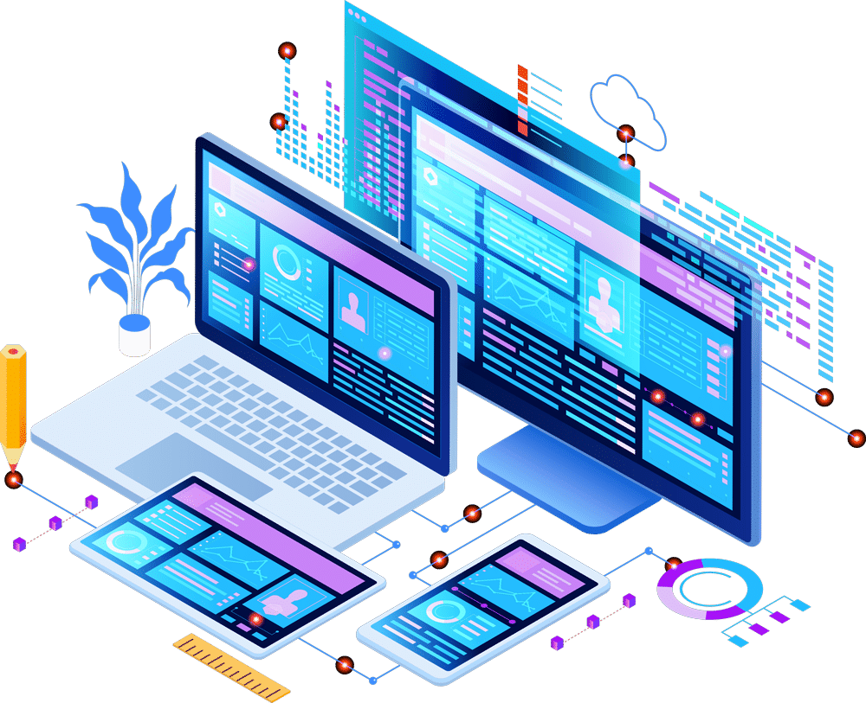

Unit-01 Introduction to JAVA
Object Oriented Programming (OOP)
(21CS01203)
Prof. Arjun V. Bala
Computer Engineering Department
arjun.bala@darshan.ac.in
9624822202

Slide 2

Outline
Introduction to JAVA
Features of JAVA
JDK
JRE
JVM
Installing and configuring JAVA
Basic structure of Java program
Compiling Java program
Running Java program
Looping

Slide 3



Slide 4
JAVA
Java is a general-purpose computer-programming language that is open source, platform independent, object-oriented and specifically designed to have as few implementation dependencies as possible.
Java was originally developed by James Gosling at Sun Microsystems and released in 1995.
Java was initially named as Oak language and renamed to JAVA in 1995.
Current Version | Java SE 17 (as of feb-2022)
Version we will use | Java SE 17 (LTS)
Setup size | 155 MB (Linux), 152 MB (Windows x64)
Download Link | https://www.oracle.com/java/technologies/downloads/
Official Website | https://java.com
Integrated Development Environment (IDE) | Eclipse (going to use this IDE in later chapters) NetBeans IntelliJ IDEA Community Edition BlueJ

Slide 5
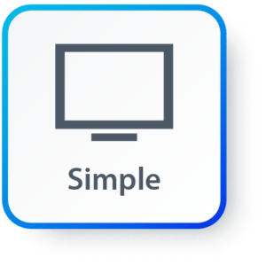
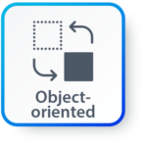
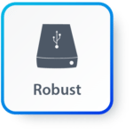
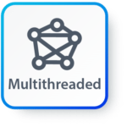
Features of JAVA
Simple: Java inherits C/C++ syntax and many object-oriented features of C++.
Object Oriented: “Everything is an object” paradigm, which possess some state, behavior and all the operations are performed using these objects.
Robust: Java has a strong memory management system. It helps in eliminating error as it checks the code during compile and runtime.
Multithreaded: Java supports multiple threads of execution, including a set of synchronization primitives. This makes programming with threads much easier.

Slide 6
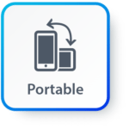


Features of JAVA (Cont.)
Architectural Neutral: Java is platform independent which means that any application written on one platform can be easily ported to another platform.
Interpreted: Java is compiled to bytecodes, which are interpreted by a Java run-time environment.
High Performance: Java achieves high performance through the use of bytecode which can be easily translated into native machine code. With the use of JIT (Just-In-Time) compilers, Java enables high performance.

Slide 7

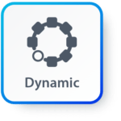
Features of JAVA (Cont.)
Distributed: Java provides a feature which helps to create distributed applications. Using Remote Method Invocation (RMI), a program can invoke a method of another program across a network and get the output. You can access files by calling the methods from any machine on the internet.
Dynamic: Java has ability to adapt to an evolving environment which supports dynamic memory allocation due to which memory wastage is reduced and performance of the application is increased.

Slide 8
Components of Java
Java Virtual Machine (JVM)
Java Runtime Environment (JRE)
Java Development Kit (JDK)
JDK
Compiler (javac.exe)
Java Application
Launcher (java.exe), AppletViewer, etc..)
Java Packages
(math, util, awt etc…)
JVM
Runtime Libraries
Development tools
JRE

Slide 9
Java Development Kit (JDK)
JDK contains tools needed ,
To develop the Java programs and
JRE to run the programs.
The tools include
compiler (javac.exe),
Java application launcher (java.exe),
Appletviewer, etc…
Java application launcher (java.exe) opens a JRE, loads the class, and invokes its main method.

Slide 10
Java Runtime Environment (JRE)
The JRE is required to run java applications.
It combines the Java Virtual Machine (JVM), platform core classes and supporting libraries.
JRE is part of the Java Development Kit (JDK), but can be downloaded separately.
It does not contain any development tools such as compiler, debugger, etc.

Slide 11
Java Virtual Machine (JVM)
JVM is a virtual machine that enables a computer to run Java programs as well as programs written in other languages and compiled to Java Bytecode.
Bytecode is a highly optimized set of instructions designed to be executed by the Java Virtual Machine(JVM).
Byte code is intermediate representation of java source code.
Java compiler provides byte code by compiling Java Source Code.
Extension for java class file or byte code is ‘.class’, which is platform independent.
JVM is virtual because , It provides a machine interface that does not depend on the operating system and machine hardware architecture.
JVM interprets the byte code into the machine code.
JVM itself is platform dependent, but Java is Not.

Slide 12
How Java become Platform Independent?
Source code (Program)
.java file
Compiler
Bytecode
.class file
JVM
(Windows)
JVM
(Linux)
JVM
(Mac)
Machine Code
Machine Code
Machine Code

Slide 13
Installing JDK
Download JDK for Windows platform (.exe) from
https://www.oracle.com/technetwork/java/javase/downloads/index.html
Install the executable of JDK
Set the path variable of System variables by performing following steps
Go to "System Properties" (Right click This PC → Properties → Advanced System Settings)
Click on the "Environment variables" button under the "Advanced" tab
Then, select the "Path" variable in System variables and click on the "Edit" button
Click on the "New" button and add the path where Java is installed, followed by \bin. By default, Java is installed in C:\Program Files\Java\jdk-11.0.1 (If nothing else was specified when you installed it). In that case, You will have to add a new path with: C:\Program Files\Java\jdk-11.0.1\bin
Then, click "OK", and save the settings
At last, open Command Prompt (cmd.exe) and type java -version to see if Java is running on your machine

Slide 14
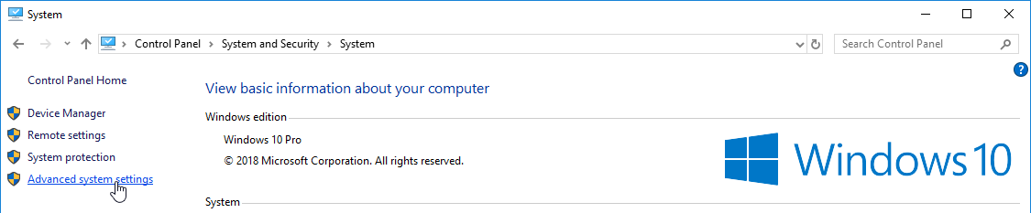
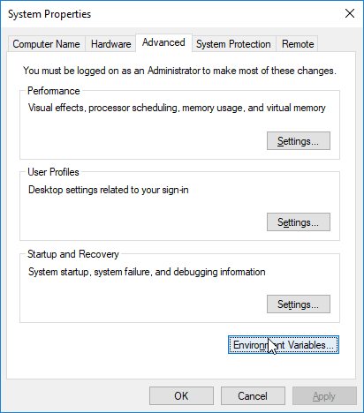
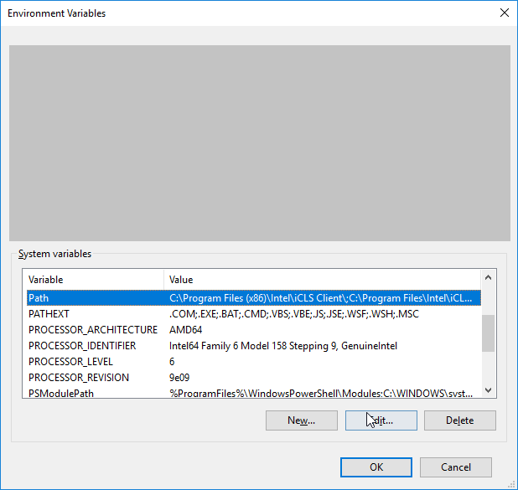
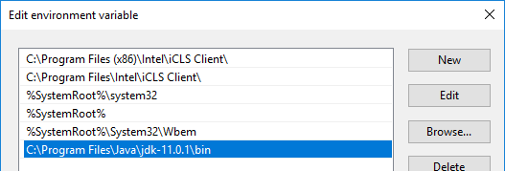
Setting Path Variable
1
2
3
4

Slide 15
Hello World Java Program
File must be saved as HelloWorld.java
public class HelloWorld
{
public static void main(String[] args)
{
System.out.println("Hello World");
}
}
We have to save this in HelloWorld.java file as it has public class named HelloWorld.
String and System are inbuilt Java Classes.
Classes in java are always written in Camel case.
Main method from where execution will start
String must start with capital letter
System must start with capital letter

Slide 16
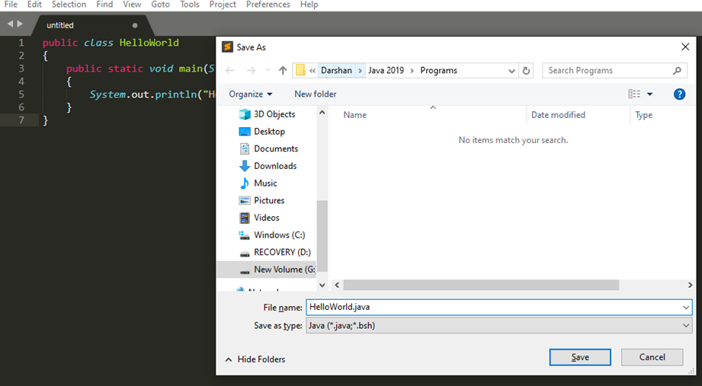
How to execute Java Program?
Save the program with the same name as the public class with .java extension.

Slide 17
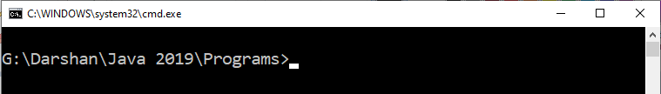
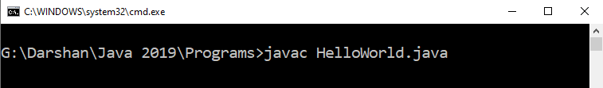
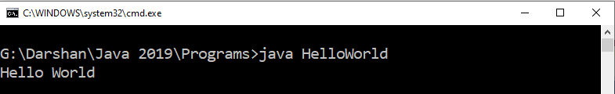
How to execute Java Program?
Open command prompt (cmd) / terminal & navigate to desired directory / folder.
Compile the “.java” file with javac command.
Execute the “.class” file with java command without extension.

